Slide 1
Artificial Intelligence
CS-451
Instructor : Syed Musharaf Ali
ROOM G-104-DSE IIUI
Ph# 051-9019724 Ext-2724

Slide 2
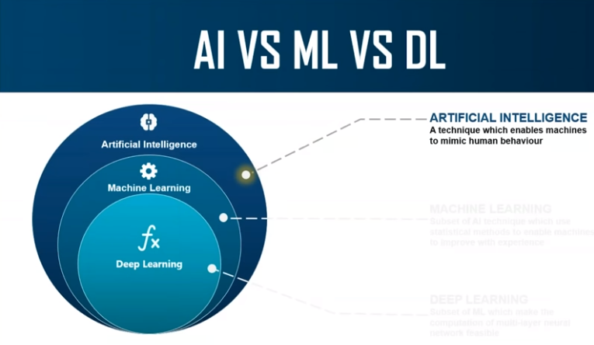
Notes:
Cognitve : process of knowing, learning

Slide 3
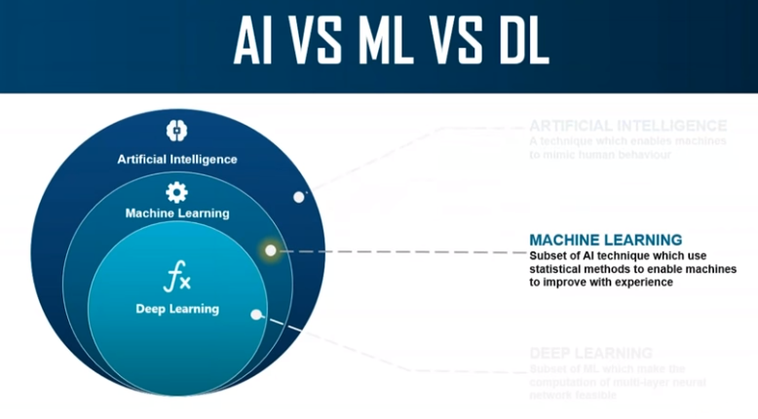
Notes:
Cognitve : process of knowing, learning

Slide 4
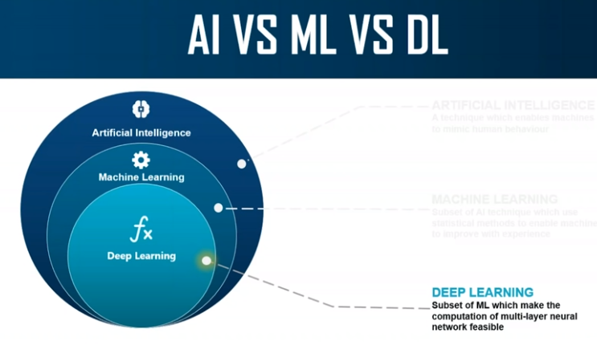
Notes:
Cognitve : process of knowing, learning

Slide 5
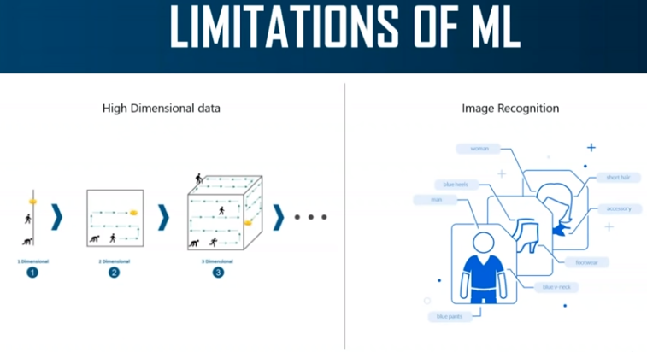
Notes:
Cognitve : process of knowing, learning

Slide 6
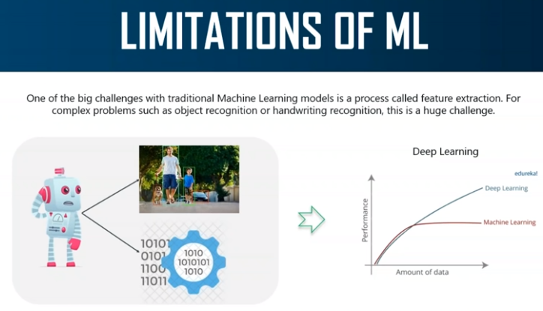
Notes:
Cognitve : process of knowing, learning

Slide 7
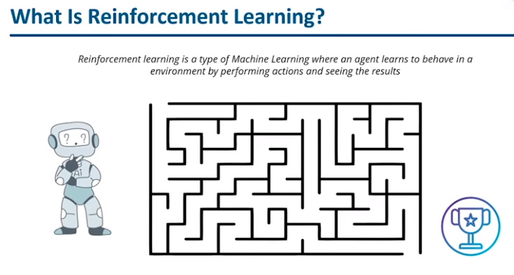
Notes:
Cognitve : process of knowing, learning

Slide 8
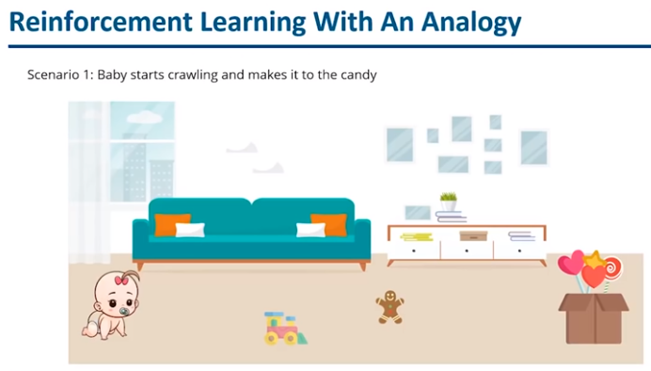
Notes:
Cognitve : process of knowing, learning

Slide 9
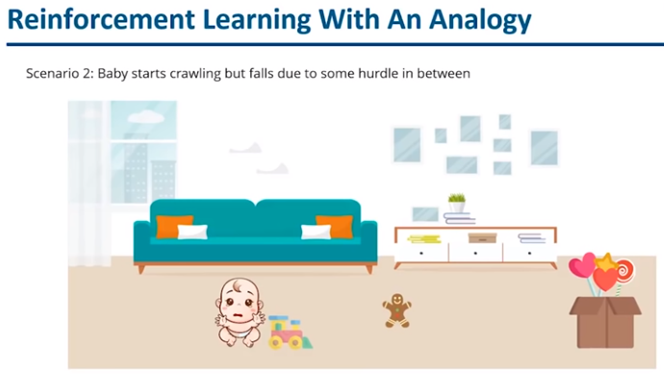
Notes:
Cognitve : process of knowing, learning

Slide 10
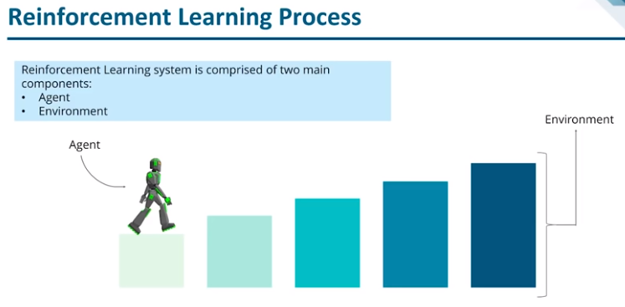
Notes:
Cognitve : process of knowing, learning

Slide 11
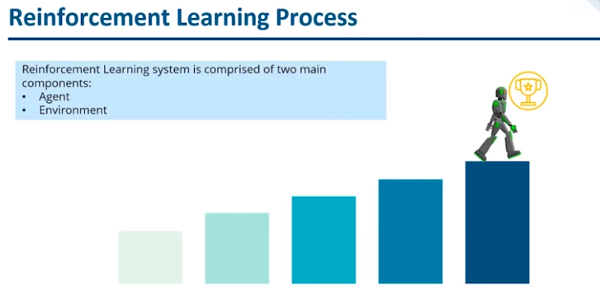
Notes:
Cognitve : process of knowing, learning

Slide 12
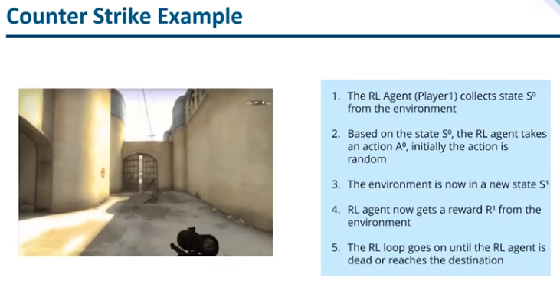
Notes:
Cognitve : process of knowing, learning

Slide 13
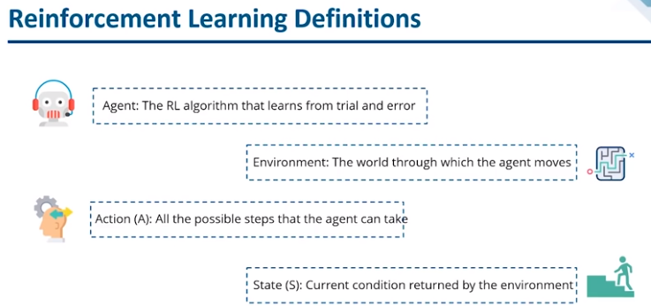
Notes:
Cognitve : process of knowing, learning

Slide 14
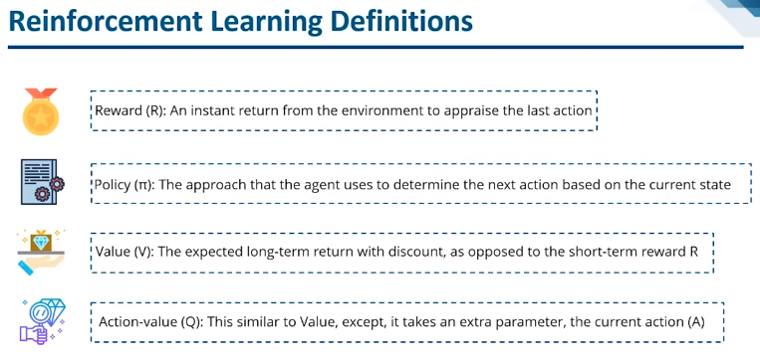
Notes:
Cognitve : process of knowing, learning

Slide 15
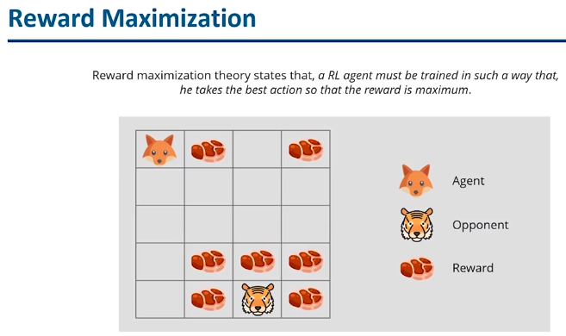
Notes:
Cognitve : process of knowing, learning

Slide 16
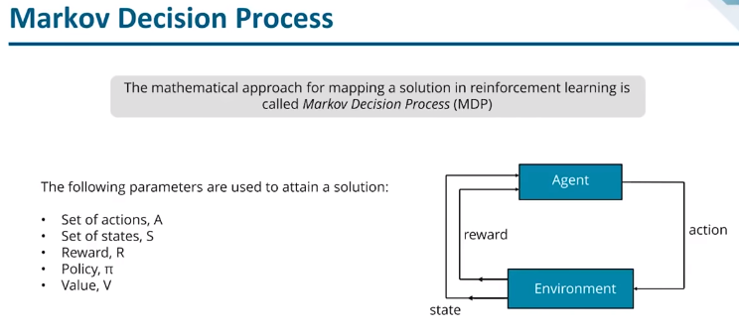
Notes:
Cognitve : process of knowing, learning

Slide 17
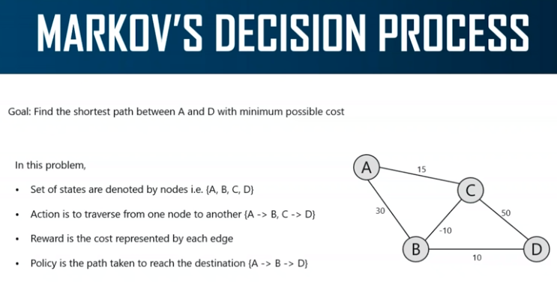
Notes:
Cognitve : process of knowing, learning

Slide 18
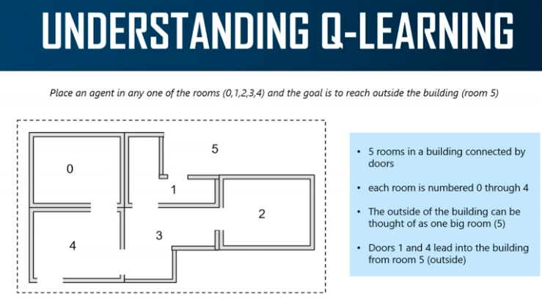
Notes:
Cognitve : process of knowing, learning

Slide 19
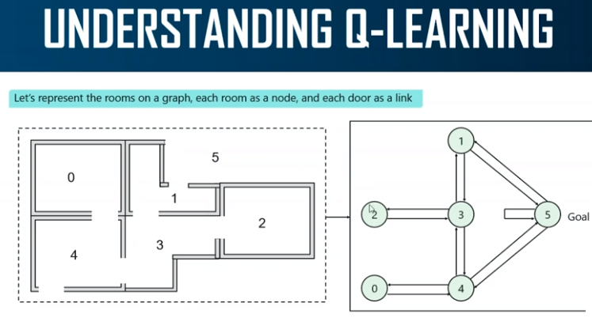
Notes:
Cognitve : process of knowing, learning

Slide 20
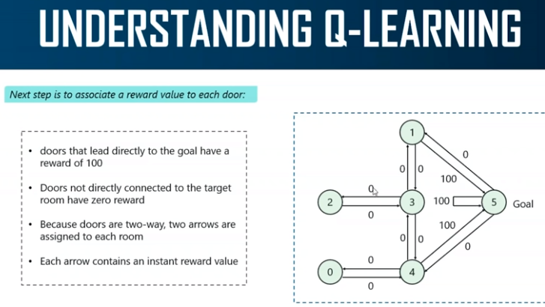
Notes:
Cognitve : process of knowing, learning

Slide 21
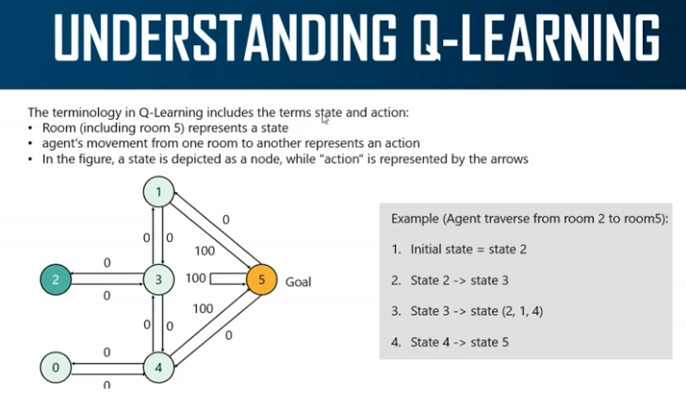
Notes:
Cognitve : process of knowing, learning

Slide 22
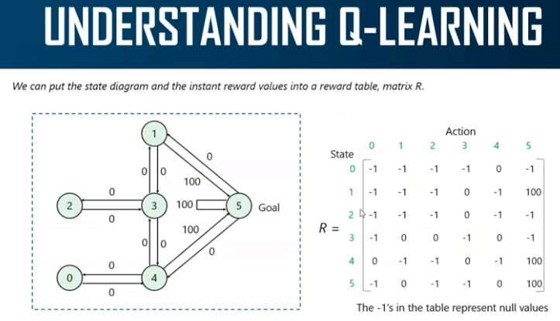
Notes:
Cognitve : process of knowing, learning

Slide 23
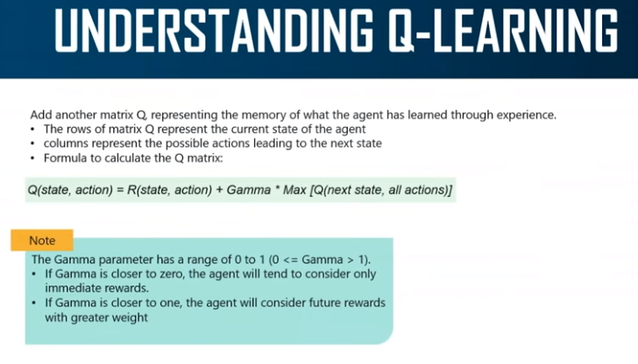
Exploitation
Exploration
Best policy found when gamma close to one
Notes:
Cognitve : process of knowing, learning

Slide 24
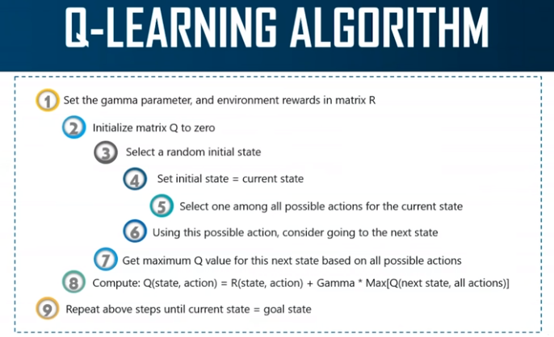
Notes:
Cognitve : process of knowing, learning

Slide 25
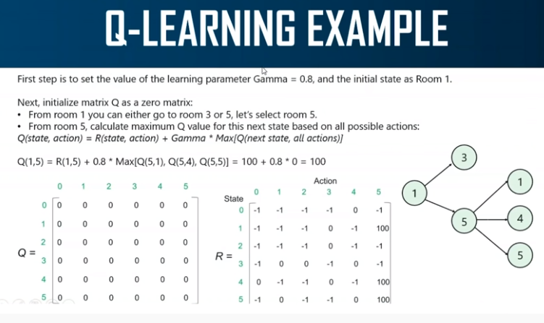
Notes:
Cognitve : process of knowing, learning

Slide 26
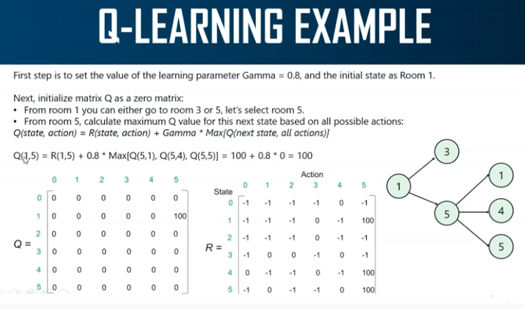
Notes:
Cognitve : process of knowing, learning

Slide 27
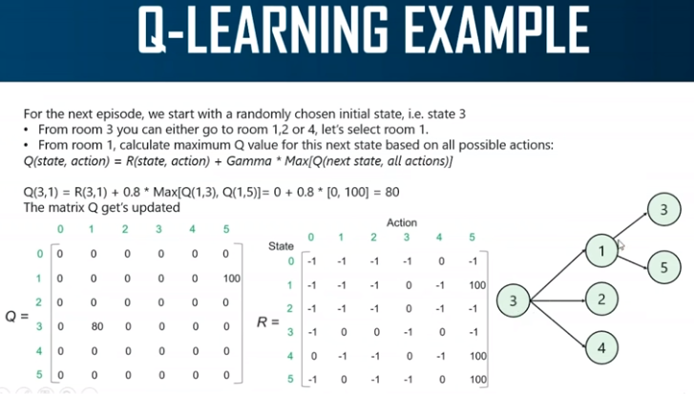
Notes:
Cognitve : process of knowing, learning

